Slide 1
Abilities using Can or Can’t
Can you ….. ?
☺ Yes, I can
☹ No, I can’t…..

Slide 2
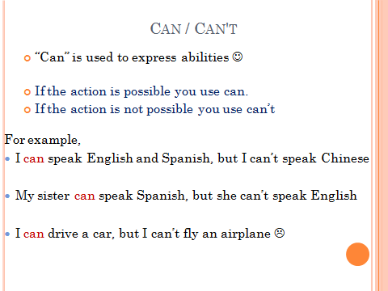

Slide 3
Swim

Slide 4
Ride a bike

Slide 5
Dance

Slide 6
Catch a ball

Slide 7
Throw a ball

Slide 8
Draw

Slide 9
Sing

Slide 10
Climb mountains

Slide 11
Play soccer

Slide 12
Cook

Slide 13
Play the piano

Slide 14
Use a computer

Slide 15
Fly

Slide 16
Count

Slide 17
Jump

Slide 18
Run

Slide 19
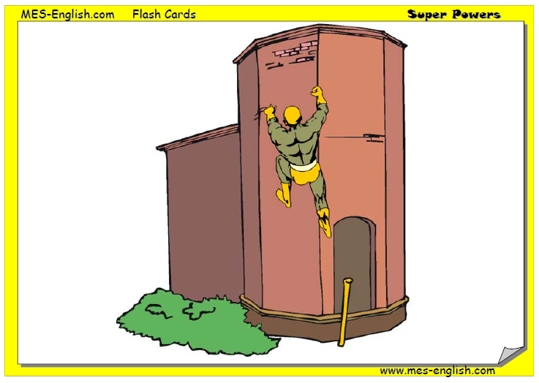
climb walls

Slide 20
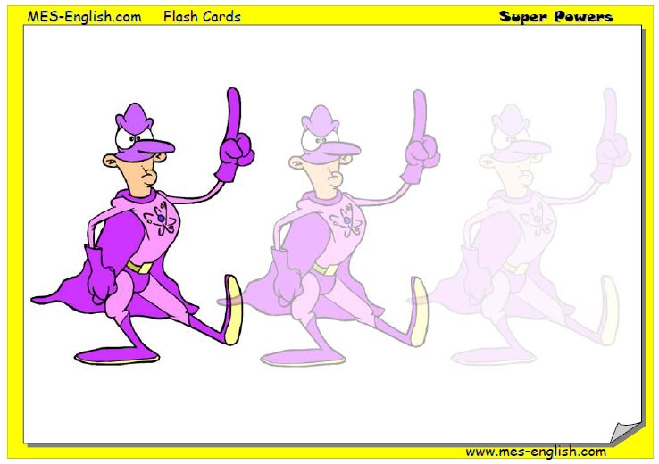
become invisible

Slide 21
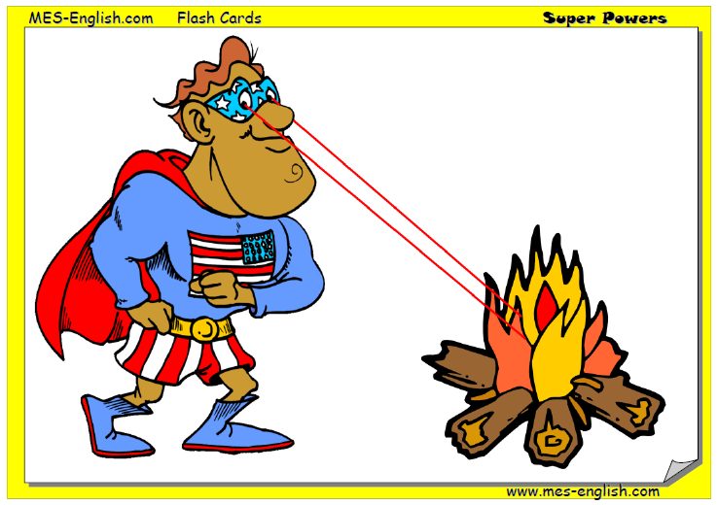
shoot lasers

Slide 22
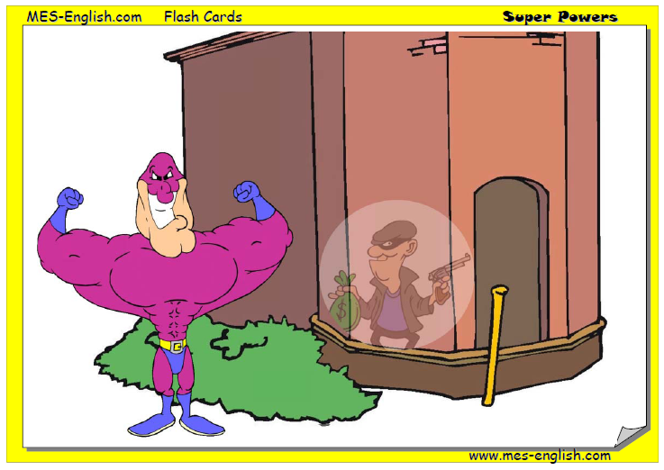
see through walls

Slide 23
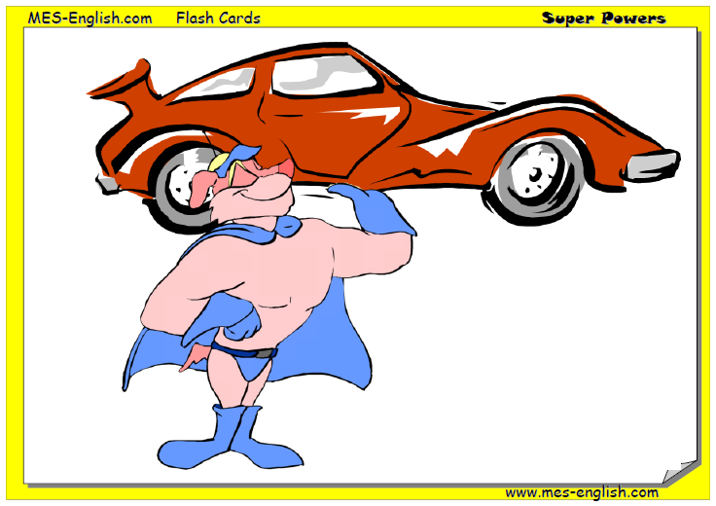
lift anything

Slide 24

Lead people
He is a museum tour guide

Slide 25
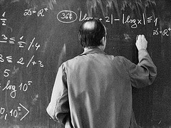
solve
He is a museum tour guide

Slide 26
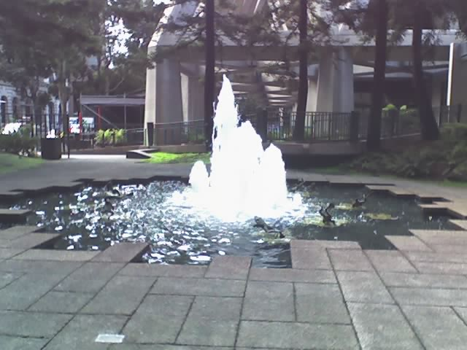
Thank you ☺

